Slide 1
Peptic Ulcer Disease
Definitions
Protective factors
Causes of PUD
Risk Factors
NSAIDS
H. Pylori
Zollinger-Ellison Syndrome
Diagnosis
Tx
Stressed induced Ulcers

Slide 2
Peptic Ulcer Disease (PUD)
Definitions
Ulcer: break in mucosal surface > 5mm in size
Peptic Ulcer Disease: disruption of mucosal integrity of the stomach and/or duodenum leading to a local defect or excavation due to active inflammation

Slide 3
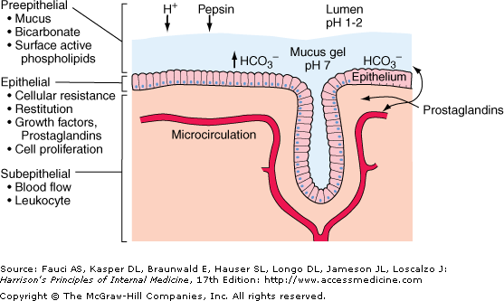
Protective Factors

Slide 4
Cause of Ulcers
Risk Factors
NSAIDS
H. Pylori
Zollinger-Ellison Syndrome

Slide 5
Cause of Ulcers: Risk Factors
Established Risk Factors
Age > 60
Hx Ulcers
High dose NSAIDS, ASA
Potential Risk Factors
H. Pylori infection
Alcohol
Cigs
RA

Slide 6
Cause of Ulcers: NSAIDS
NSAIDS
MOA | Inhibit COX-1 → decrease Prostaglandin
Result | Less mucosal defense Increase Acid Output
Incidence | Up to 30%
Toxicity | More Toxic --------------------------------------------> Less Toxic
Tx | If OFF NSAID, use PPI for 4 weeks If ON NSAID, use PPI for 8-12 weeks
Ketorolac, Piroxicam
Naproxen, Indomethacin, Diclofenac
Low dose ibuprofen
< 600 mg/day
Celecoxib, Nabumetone, Meloxicam

Slide 7
Cause of Ulcers
H. Pylori
MOA | Gram - infectious bacteria that causes chronic gastritis
Transmitted | Fecal to Oral
Zollinger- Ellison Snydrome
MOA | Tumor in duodenum called gastrinomas, secrete large amounts of gastrin → excess acid → ulcers

Slide 8
Diagnosis
Diagnose PUD | Pros
Upper GI radiography | Costs Less Greater safety
Upper Endoscopy
NON - INVASIVE diagnosis for H. Pylori | Pros | Cons
Urea Breath | Sensitive and specific Good for early followup | False negative if use PPI Antibiotics
Stool Antigen | Convenient Tests for active H. pylori infection | False negative if use PPI antibiotics
Antibody Detection | Results within 15 min | Unsure if antibody is active or cured
INVASIVE diagnosis for H. Pylori | Pros | Cons
Histology | Gold Standard Can classify gastritis for infection | Invasive Not used for initial diagnosis
Rapid Urease | Simple | False negatives if use: PPI Antibiotics
Culture | 100% specific | Use after failure of 2nd line Tx $$ and Time consuming

Slide 9
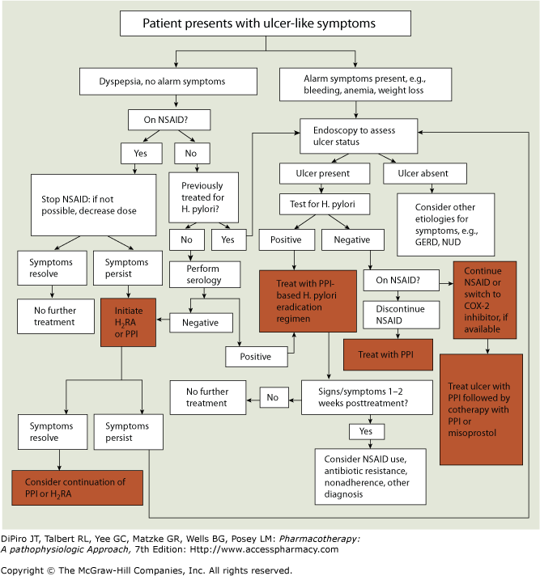
Drugs (next slides):
PPI/H2 antag
Sucralfate
Bismuth Subsalicylate
Misoprostol
Antibiotics (for H. pylori)

Slide 10
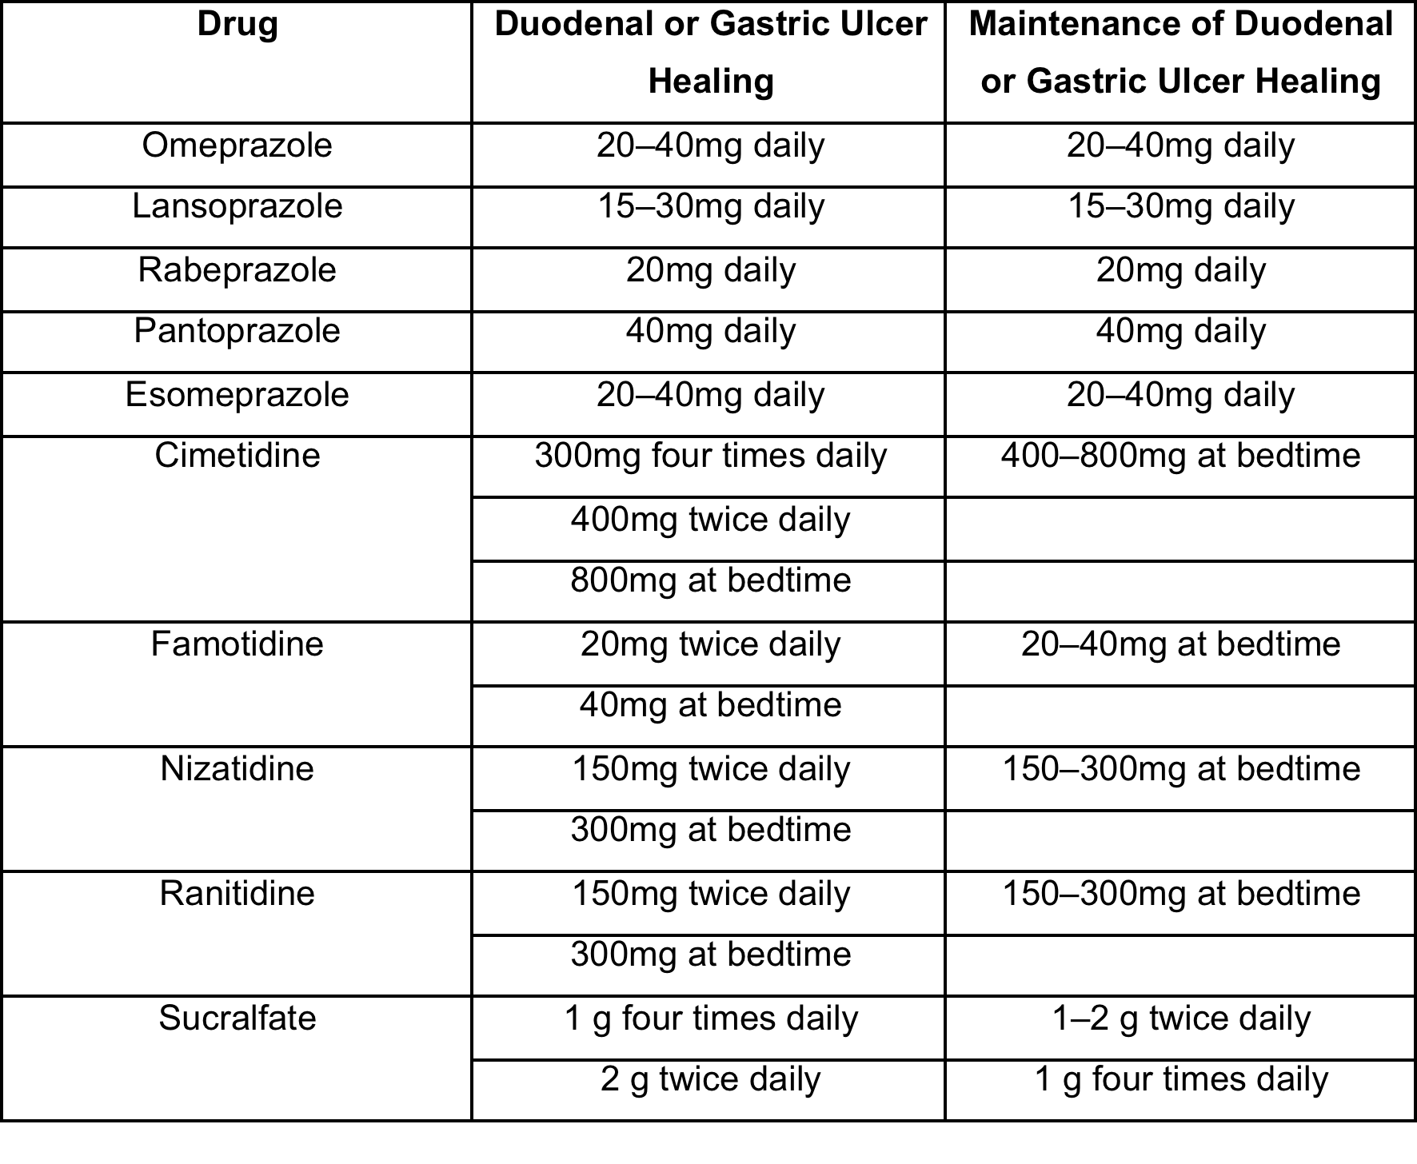
PPI and H2 antag

Slide 11
Sucralfate
MOA | Inhibits pepsin activity Increase production of prostaglandin
Dosing | 1 g/10 mL Take on empty stomach to prevent protein and phosphate binding
S/E | Take other meds 2 hours before sucralfate
Bismuth Subsalicylate
MOA | Antibacterial effect Local gastro protective effect Stimulation of endogenous prostaglandins
Dosing | 262 mg/15 mL or 525 mg/15mL
S/E | Salicylate sensitivity D/D with Tetracycline (used in tx)
Misoprostol
MOA | Prostaglandin used for prevention of NSAID induced ulcers
Dosing | 200 mcg PO TID with food (600 mcg/day for effect)
S/E | Abdominal cramping (dosing based on cramping) Pregnancy X
Notes:
Sucralfate
Bismuth Subsalicylate
Misoprostol

Slide 12
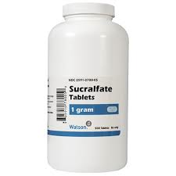
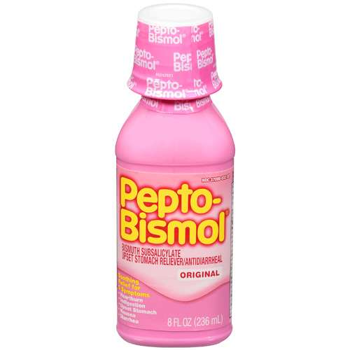
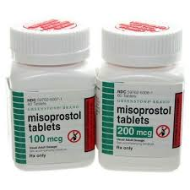

Slide 13
First line Tx. H Pylori
For 14 days
PPI BID
+
Clarithromycin 500 mg BID
+
Amoxicillin 1 g BID
PPI BID
+
Clarithromycin 500 mg BID
+
Metronidazole 500 mg BID
PPI BID
+
Metronidazole 250 mg QID
+
Tetracycline 500 mg QID
+
Bismuth Subsalicylate 525 mg PO QID
Tx for 14 days
Test again 4 weeks after completion of Tx
PPI |  | Dose
Esomeprazole | nexium | 40 mg DAILY
Omeprazole | prilosec | 20 mg BID
Lansoprazole | prevacid | 30 mg BID
Pantoprazole | protonixs | 40 mg BID
Rabeprazole | aciphex | 20 mg BID
Notes:
Know dosing for PPI and antibiotics
Metronidazole + alcohol = throw up

Slide 14
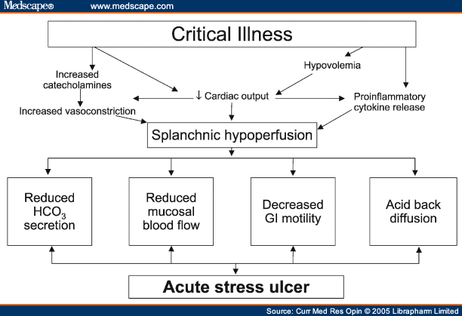
Stressed Induced Ulcers
Risk Factors:
Respiratory failure
Coagulopathy
Anticoagulation
Hypotension
Severe burns
Sepsis
Acute renal or hepatic failure
Multiple trauma
Severe head or spinal cord injury
H/o GIB
Major surgery
PPI Prophylaxis | Dosing
Omeprazole | Loading: 40 mg PO/IV 6-8h x2 Maintenance: 40 mg PO/IV q24h
Pantoprazole | 40 mg PO/IV q24h
H2 Prophylaxis | Dosing
Famotidine | 20 mg PO/IV q12h
Ranitidine | 150 mg PO/IV q12h

